Slide 1
FCS (Graphs)
Dr. adeel hashmi
Asst. prof., cse 2nd shift
msit

Slide 2
Graphs
A graph G = (V, E) consists of V, a non-empty set of vertices (or nodes) and E, a set of edges.
Two vertices u and v in an undirected graph G are called adjacent (or neighbors) in G if u and v are the endpoints of an edge e of G.
Edges that connect a vertex to itself are called loops.

Slide 3
Types of Graphs
A graph in which each edge connects two different vertices and where no two edges connect the same pair of vertices is called a simple graph.
Graphs that may have multiple edges connecting the same vertices are called multigraphs. When there are m directed edges, each associated to an ordered pair of vertices (u, v), we say that (u, v) is an edge of multiplicity m.
Graphs that may include loops, and possibly multiple edges connecting the same pair of vertices or a vertex to itself, are sometimes called pseudo-graphs.

Slide 4
Types of Graphs (2)
A directed graph / digraph (V,E) consists of a nonempty set of vertices V and a set of directed edges (or arcs) E. Each directed edge is associated with an ordered pair of vertices. The directed edge associated with the ordered pair (u, v) is said to start at u and end at v. The converse of a directed graph is the directed graph with directions of all edges reversed.
So far the graphs we have introduced are undirected graphs. Their edges are also said to be undirected. A graph with both directed and undirected edges is called a mixed graph.

Slide 5
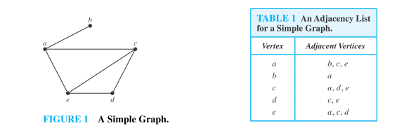
Graph Representation
A graph can be represented as either Adjacency Matrix or Adjacency List or Incidence Matrix.

Slide 6
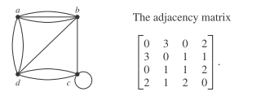
Graph Representation (2)

Slide 7
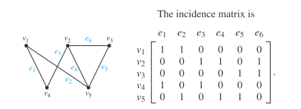
Graph Representation (3)

Slide 8
Degree of vertices
The degree of a vertex in an undirected graph is the number of edges incident with it, except that a loop at a vertex contributes twice to the degree of that vertex. The degree of the vertex v is denoted by deg(v).
In a graph with directed edges the in-degree of a vertex v, denoted by deg−(v), is the number of edges with v as their terminal vertex. The out-degree of v, denoted by deg+(v), is the number of edges with v as their initial vertex. (Note that a loop at a vertex contributes 1 to both the in-degree and the out-degree of this vertex.)

Slide 9
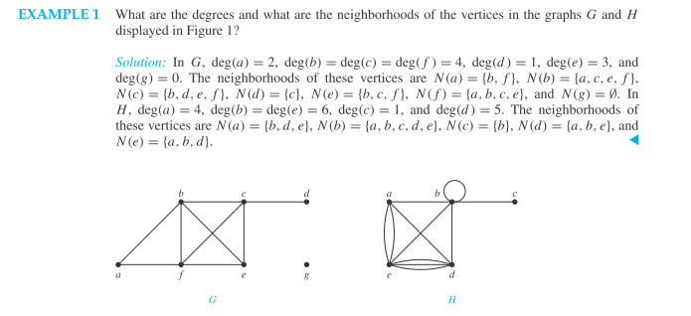
Question-1

Slide 10
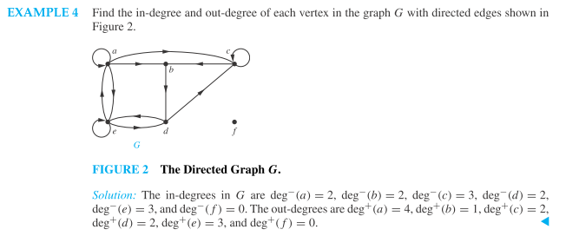
Question-2

Slide 11
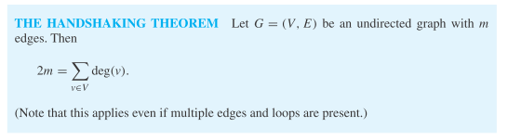

Hand-shaking theorem

Slide 12
Isomorphic
Two graphs are said to be isomorphic, if
They have an equal number of vertices.
They have an equal number of edges.
They have an equal number of vertices for each degree.
The sub-graphs formed by vertices for a given degree, also have equal number of vertices for each degree.

Slide 13
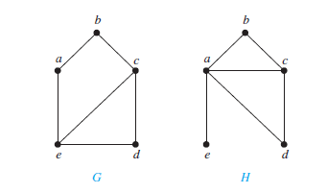
Question-1
Are the following graphs isomorphic?
Both G and H have five vertices and six edges. However, H has a vertex of degree one, namely, e, whereas G has no vertices of degree one. It follows that G and H are not isomorphic.

Slide 14
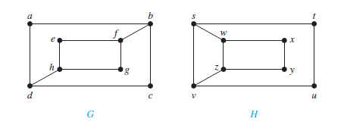
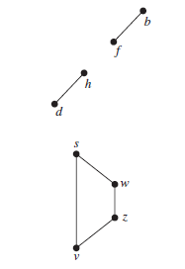
Question-2
Are the following
graphs isomorphic?
The graphs G and H both have
eight vertices and 10 edges.
They also both have four vertices
of degree two and four of degree three.
But it is not isomorphic,
as sub-graphs of vertices having
degree 3 are not isomorphic.

Slide 15
Connected Graphs
A path/walk is a sequence of vertices/edges e.g. v₁v₄v₃v₂ . A path which begins and ends at the same vertex is called a cycle or a circuit.
An undirected graph is called connected if there is a path b/w every pair of distinct vertices of the graph.
A directed graph is strongly connected if there is a path from a to b and from b to a whenever a and b are vertices in the graph. A directed graph is weakly connected if there is a path between every two vertices in the underlying undirected graph.

Slide 16
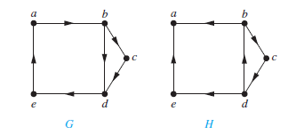
Example
Are the following graphs connected?
G is strongly connected because there is a path between any two vertices in this directed graph.
The graph H is not strongly connected. There is no path from a to b in this graph. However, H is weakly connected, because there is a path b/w any two vertices in the underlying undirected graph of H.

Slide 17
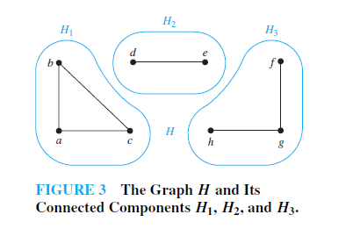
Connected Components
A connected component of a graph G is a maximal connected subgraph of G.
If the removal of an edge from a graph results in a disconnected graph, then it is called a cut-edge. Similarly, if the removal of a vertex and all incident edges results in a disconnected graph, then it is called a cut-vertex.

Slide 18
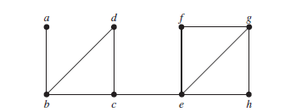
Cut-set
Find the cut vertices and cut edges in the graph G1 shown in Figure.
The cut vertices of G1 are b, c, and e. The removal of one of these vertices (and its adjacent edges) disconnects the graph. The cut edges are {a, b} and {c, e}. Removing either one of these edges disconnects G1.

Slide 19
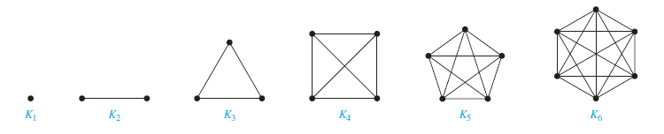
Complete Graph
A complete graph on n vertices, denoted by K_{n}, is a simple graph that contains exactly one edge between each pair of distinct vertices.
K_{n} as n(n-1)/2 edges.

Slide 20
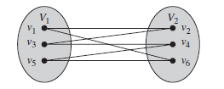
Bi-partite Graph
A simple graph G is called bipartite if its vertex set V can be partitioned into two disjoint sets V1 and V2 such that every edge in the graph connects a vertex in V1 and a vertex in V2 (so that no edge in G connects either two vertices in V1 or two vertices in V2). When this condition holds, we call the pair (V1, V2) a bipartition of the vertex set V of G.

Slide 21
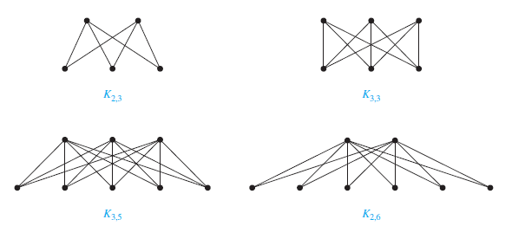
Complete Bi-partite Graphs
A complete bipartite graph K_{m,n} is a graph that has its vertex set partitioned into two subsets of m and n vertices, respectively with an edge between two vertices if and only if one vertex is in the first subset and the other vertex is in the second subset.

Slide 22
Euler Path
A Euler path in G is a simple path containing every edge of G (each edge only once).
A Euler circuit in a graph G is a simple circuit containing every edge of G.
A connected multi-graph with at least two vertices has an Euler circuit if and only if each of its vertices has an even degree.
A connected multigraph has an Euler path but not an Euler circuit if and only if it has exactly two vertices of odd degree.

Slide 23
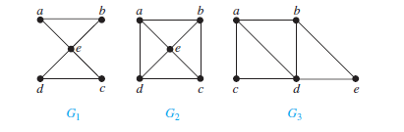
Example
Which of the undirected graphs in Fig. have a Euler circuit? Of those that do not, which have a Euler path?
The graph G1 has Euler circuit(s), one such circuit is a, e, c, d, e, b, a. Neither of the graphs G2 or G3 has an Euler circuit. However, G3 has an Euler path, namely, a, c, d, e, b, d, a, b. G2 does not have an Euler path.

Slide 24
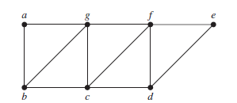
Hamiltonian Path
A simple path in a graph G that passes through every vertex exactly once is called a Hamiltonian path, and a simple circuit in a graph G that passes through every vertex exactly once is called a Hamiltonian circuit.
a, g, f, e, d, c, b, a is one of the Hamiltonian circuit.
a,b,g,c,f,d,e is one of th Hamiltonian path.

Slide 25
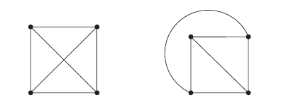
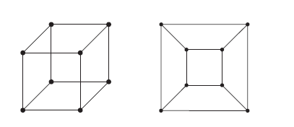
Planar Graph
A graph is called planar if it can be drawn/re-drawn in the plane without any edges crossing.

Slide 26
Homeomorphic
If a graph is planar, so will be any graph obtained by removing an edge {u, v} and adding a new vertex w together with edges {u, w} and {w, v}. Such an operation is called an elementary subdivision.
The graphs G1 = (V1, E1) and G2 = (V2, E2) are called homeomorphic if they can be obtained from the same graph by a sequence of elementary subdivisions.

Slide 27
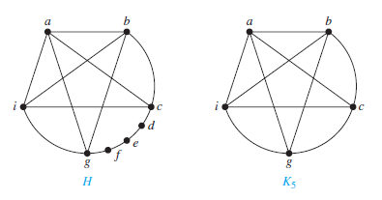
Homeomorphic (2)
A graph H homeomorphic to K₅.

Slide 28
Kuratowski theorem
A graph is nonplanar if and only if it contains a subgraph homeomorphic to K_{3,3} or K₅.

Slide 29
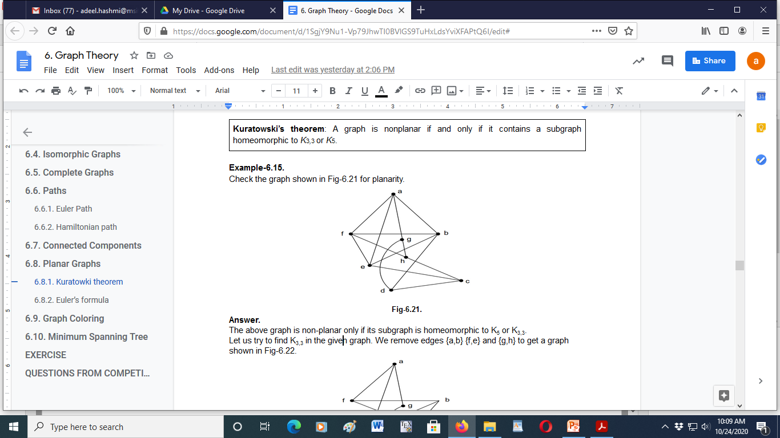
Example
Check the graph shown in Fig for planarity.

Slide 30
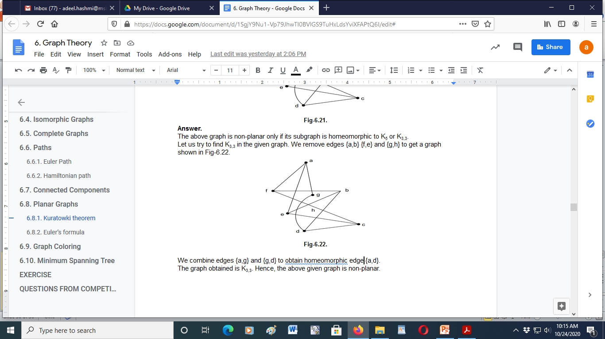
Example (2)
The above graph is non-planar only if
its subgraph is homeomorphic to K₅ or K_{3,3}.
Let us try to find K_{3,3} in the given graph. We remove edges {a,b} {f,e} and {g,h} to get a graph shown in Fig. We combine edges {a,g} and {g,d} to obtain homeomorphic edge {a,d}.
The graph obtained is K_{3,3}. Hence, the above given graph is non-planar.

Slide 31
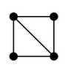
Euler formula
Let G be a connected planar simple graph with e edges and v vertices. Let r be the number of regions in a planar representation of G. Then
r = e − v + 2.
3 = 5 – 4 + 2

Slide 32
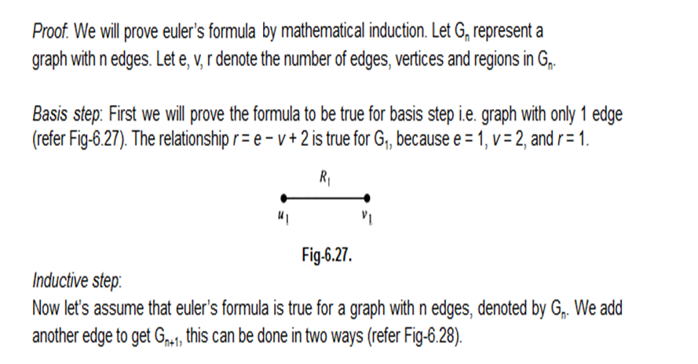
Euler formula (Proof by MI)

Slide 33
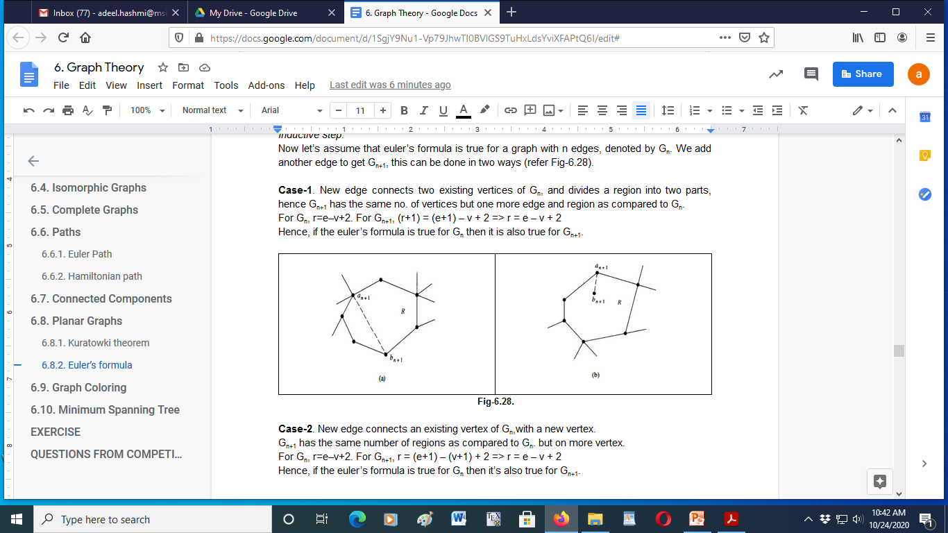
Euler formula (Proof) contd..

Slide 34
Theorem
If G is a connected planar simple graph, then G has at least one vertex of degree not exceeding five.

Slide 35
Graph Coloring
A coloring of a simple graph is the assignment of a color to each vertex of the graph so that no two adjacent vertices are assigned the same color.
The chromatic number of a graph is the least number of colors needed for a coloring of this graph. The chromatic number of a graph G is denoted by 𝝌(G). (Here 𝝌 is the Greek letter chi.)

Slide 36
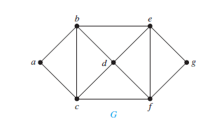
Question
What is the chromatic number of the graph shown in Fig?
Let a=Red, b=Yellow, c=Green.
Now, d can be colored Red as it is not connected to a.
e can be colored Green as it is not connected to c.
f can be colored Yellow as it is not connected to b.
And, g can be colored Red as it is not connected to either a or d.
Hence, we can color the given graph by using at least 3 colors.
Hence, its chromatic number is 3.

Slide 37
Five-color theorem
The chromatic number of a planar graph is not greater than five.

Slide 38
Five-color theorem (Proof by MI)
Basis step: Every graph with 5 or fewer vertices can be colored with 5 or fewer colors.
Inductive step: We know that every planar graph has at least one vertex of degree not exceeding 5. We take a graph with k+1 vertices (G_{k+1}) having a vertex “v” with degree 5. We remove the vertex “v” to get a graph with k vertices (G_{k}).
We assume G_{k} to be 5-colorable, and prove that G_{k+1} is also 5-colorable.

Slide 39
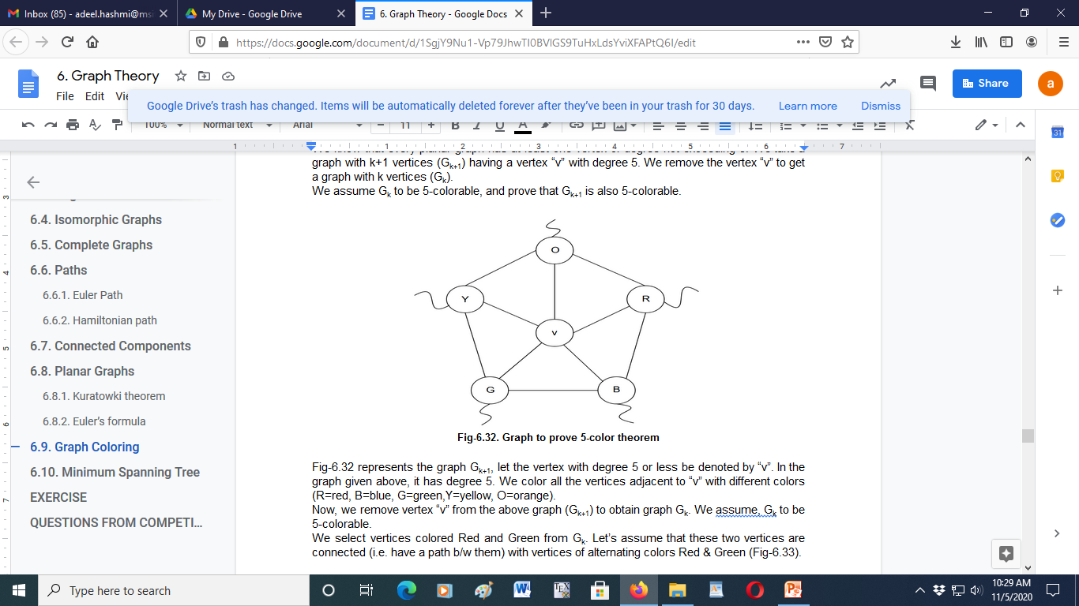
Proof (2)
Let above figure represent graph G_{k+1}, let the vertex with degree 5 or less be denoted by “v”. In the graph given above, it has degree 5. We color all the vertices adjacent to “v” with different colors (R=red, B=blue, G=green, Y=yellow, O=orange).
Now, we remove vertex “v” from the above graph (G_{k+1}) to obtain graph G_{k}. We assume, G_{k} to be 5-colorable.

Slide 40
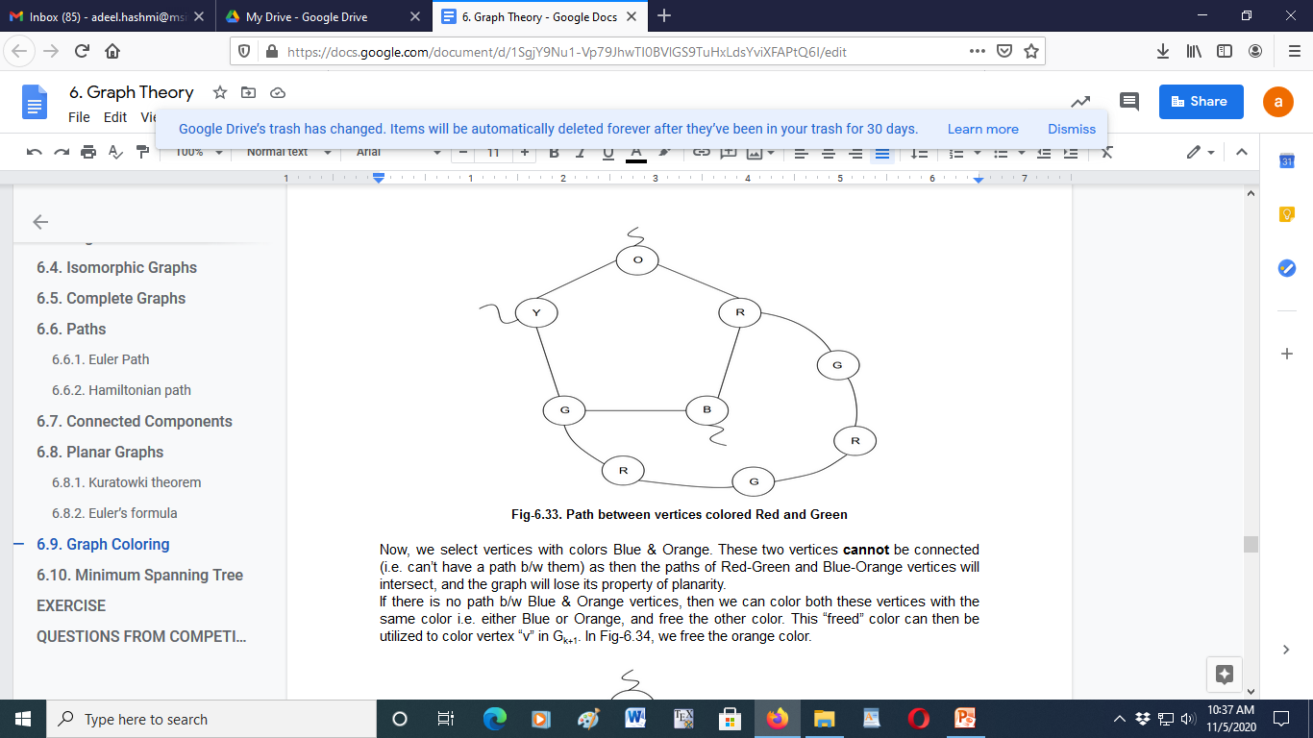
Proof (3)
We select vertices colored Red and Green from G_{k}. Let’s assume that these two vertices are connected (i.e. have a path b/w them) with vertices of alternating colors Red & Green.

Slide 41
Proof (4)
Now, we select vertices with colors Blue & Orange. These two vertices cannot be connected (i.e. can’t have a path b/w them) as then the paths of Red-Green and Blue-Orange vertices will intersect, and the graph will lose its property of planarity.
If there is no path b/w Blue & Orange vertices, then we can color both these vertices with the same color i.e. either Blue or Orange, and free the other color. This “freed” color can then be utilized to color vertex “v” in G_{k+1}. So we free the orange color.

Slide 42
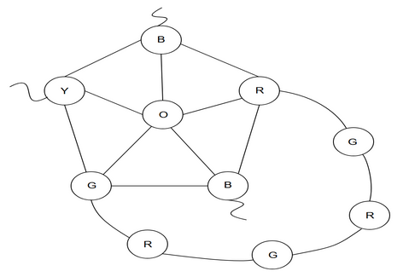
Proof (5)

Slide 43
Thank You

